Slide 1

Spam detection on mobile phone SMS performance using FP-growth and Naive Bayes Classifier
Guided by:
Notes:
Algerian
1

Slide 2
Abstract:
SMS (Short Message Service) is still the primary choice as a communication medium even though nowadays mobile phone is growing with a variety of communication media messenger applications. However, nowadays along with the SMS tariff reduction leads to the increase of SMS spam, as used by some people as an alternative to advertise and fraud. Therefore, it becomes an important issue as it can bug and harm the users and one of its solutions is with automatic SMS spam filtering.
One of most challenging in SMS spam filtering is its accuracy. In this research we proposed to enhance SMS spam filtering performance by combining two of data mining task association and classification. FP-growth in association is utilized for mining frequent pattern on SMS and Naive Bayes Classifier is used to classify whether SMS is spam or ham. Training data was using SMS spam collection from previous research. The result of using collaboration of Naive Bayes and FP-Growth performs the highest average accuracy of 90%.FP-Growth for dataset SMS Spam Collection and improves the precision score; thus, the classification result is more accurate.

Slide 3
Existing System:
Now a day’s true caller is that existing system which can block these senders message whose messages are annoying you but we have a control over the sender but not ones the type of messages. So we need such technology/system which can block the particular kind of messages.
Disadvantages:
Suppose it a user don’t want any promotional message and it he knows which all users can send him these kinds of messages then he/she can block these senders.
But if these blocked users any informational message to the user then user will not be able to receive the message.

Slide 4

Proposed system:
We are using Machine Learning algorithm (Naïve Bayes Algorithm) to eradicate such problem. In this algorithm model will train the machine by its 70% and 30% of dataset. Through this 70% data our machine will be trained enough to decide which is the SPAM message or which is the HAM message.
Advantages :
we can easily block the unnecessary messages compare to existing system. Then the proposed system will distinguish between SPAM & HAM.
we are not supposed to block the users we can just oppose or block that type of least important message without blocking the user. So the users can send any important message.
Notes:
4

Slide 5
MODULES
1.DATA SET AND RUNNING ENVIRONMENT:We have manually collected a British English data set consisting of 425 SMS spam messages from the GrumbleText website. The GrumbleText website receives SMS spam reported by volunteer users. However, because of privacy concerns, private data, such as name, address and phone number, have been removed. The SMS are not chronologically sorted. We argue that our data set is reliable for this research. Compared with another public data set [25],** our data set’s messages are in the same language (British English) and from the same society (Britain).
2.FEATURE EXTRACTION:An English stop word is used to remove meaningless words because these words exist in both e-mail spam and e-mail ham. However, removing such words will reduce the number of useful features to analyze because SMS is very short. As a simple example, we have two SMS spam: “$$$ buy free Viagra!” and “free SMS!”, also one SMS ham: “buy book :p”. We obtain five words: “buy”, “free”, “Viagra”, “SMS”, and “book”. These words then enter the word vocabulary (|v|).
Notes:
5

Slide 6
3.VECTOR CREATION:Vector creation is a process used to map a raw tokenized word into numerical data that is ready to be classified by the text classification algorithm. We propose to use Word Occurrences because of its simplicity as our proposed approach was designed for mobile phones. We just need to count the number of words in each SMS message.
4.NAÏVE BAYES:Once the word occurrences table is built, we can apply the Naïve Bayes approach to filter unknown incoming SMS. e the probability of SMS ham is higher than the probability of SMS spam, we can say that the SMS is ham. Intuitively, a human will agree that the SMS is ham, not spam, because there is no word, such as “free” or “Viagra”, present that is usually present in SMS spam. However, if the vocabulary count is high and the number of words is high, then the probability value will be too low for the processor to run the mathematical calculation, especially in a mobile phone. This problem is termed the underflow problem.
Notes:
6

Slide 7
5.UPDATING FILTERING METHOD: The feature extraction and vector creation steps are part of the training process. The filtering process step is part of the classification process. If we receive a new SMS and want to update the filtering system, we just need to repeat the feature extraction and vector creation steps. If the word already exists in the word occurrences table, we will just update the word occurrences table. If the word does not exist.
Notes:
7

Slide 8
SYSTEM REQUIREMENTS:
Hardware requirements:
System : Intel CORE i3
Hard Disk : 40 GB.
Floppy Drive : 1.44 Mb.
Monitor : 15 VGA Colour.
Mouse : Logitech.
Ram : 2GB.
Software requirements:
Operating system : Windows 7/8/10
Coding Language : Python
IDE : Anaconda(spyder, Jupiter), Python IDLE 2.7/3.6
Database : CSV File, TSV File.
Notes:
8

Slide 9
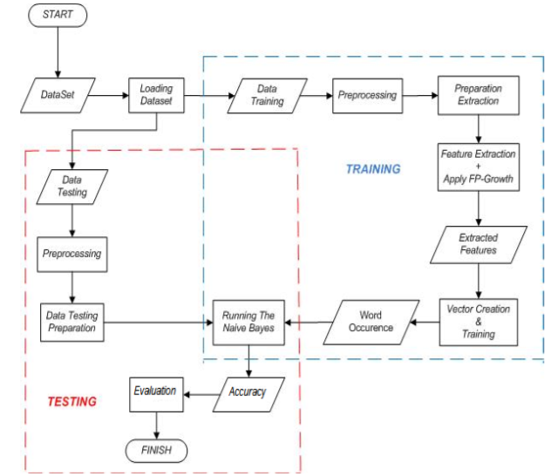
Flow chart:

Slide 10
UML Diagrams

Slide 11
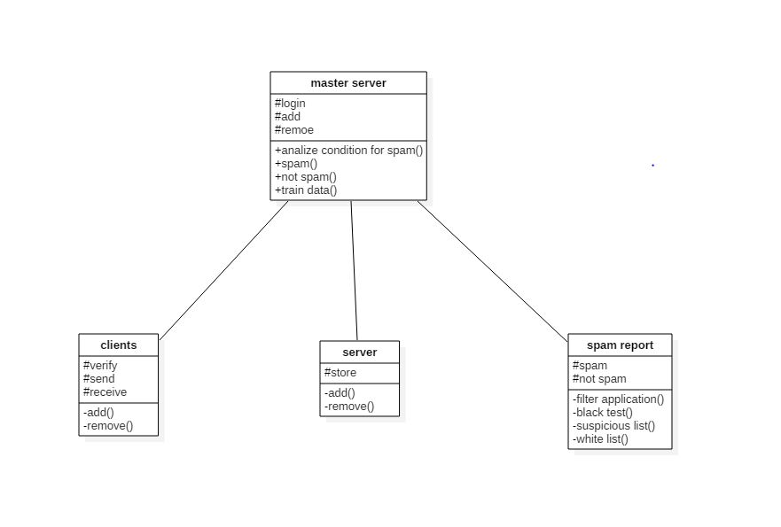
Class Diagram:
Notes:
11

Slide 12
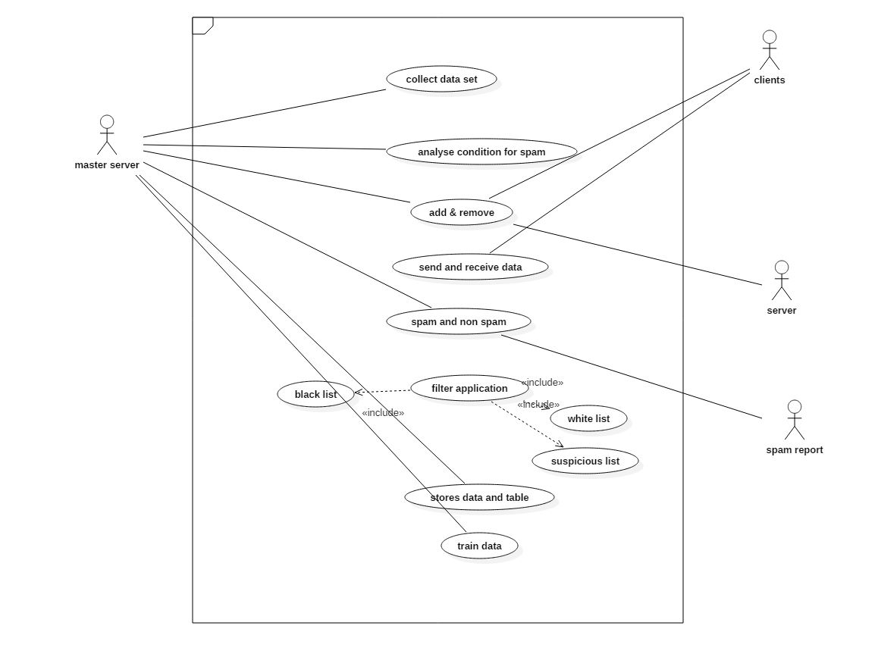
Use Case Diagram:

Slide 13
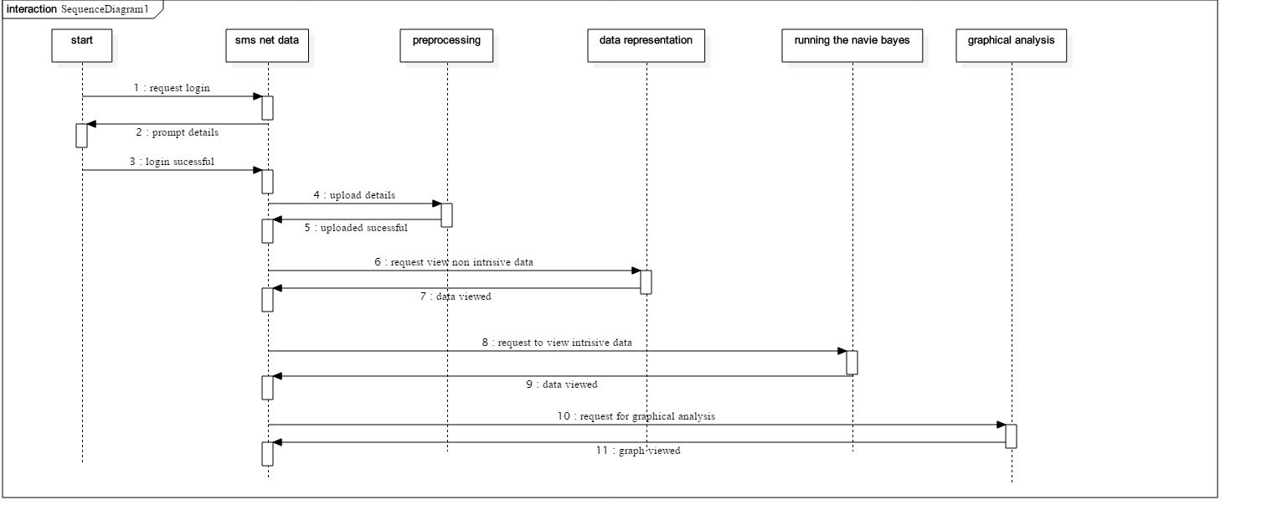
Sequence Diagram:
Notes:
13

Slide 14
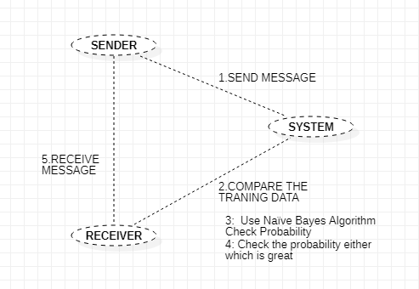
Collaboration Diagram:
Notes:
14

Slide 15
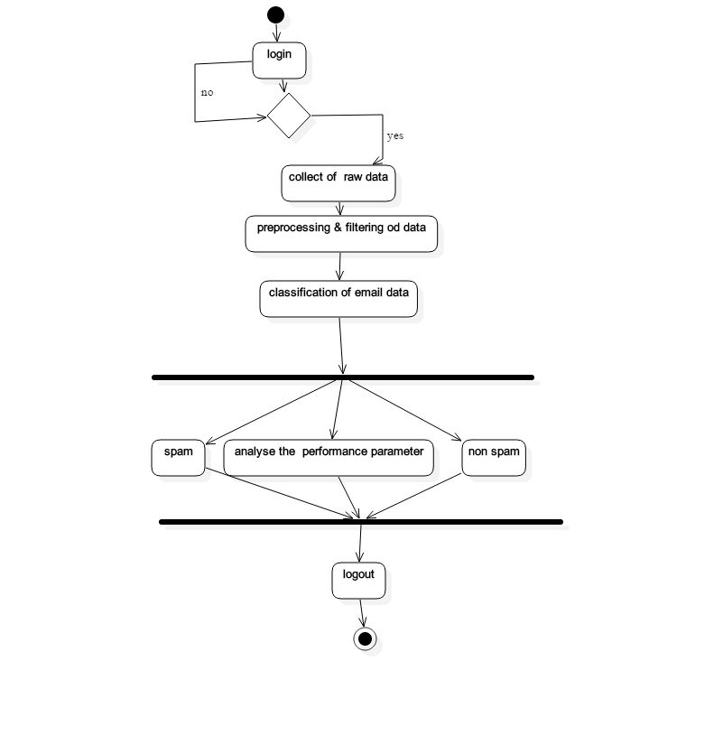
Activity Diagram:
Notes:
15

Slide 16
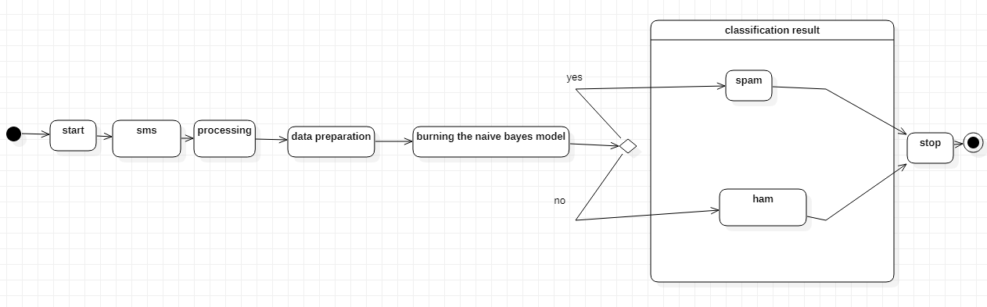
State Chart Diagram:
Notes:
16

Slide 17
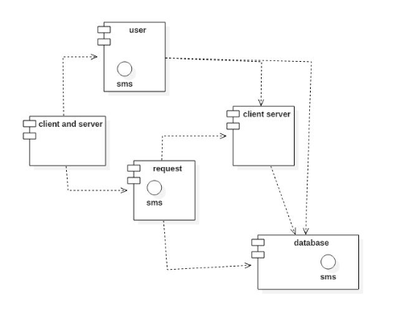
Component Diagram:

Slide 18
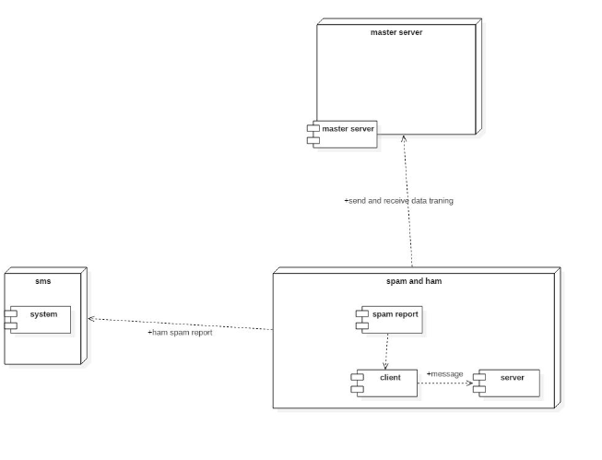
Deployment Diagram:
Notes:
18

Slide 19
Output Screens
Notes:
19

Slide 20
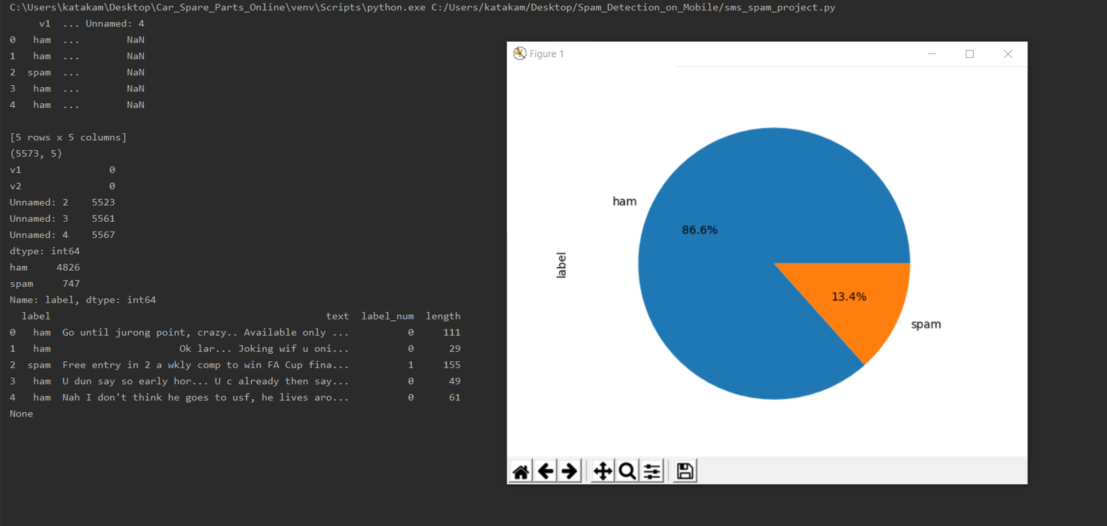
Notes:
20

Slide 21
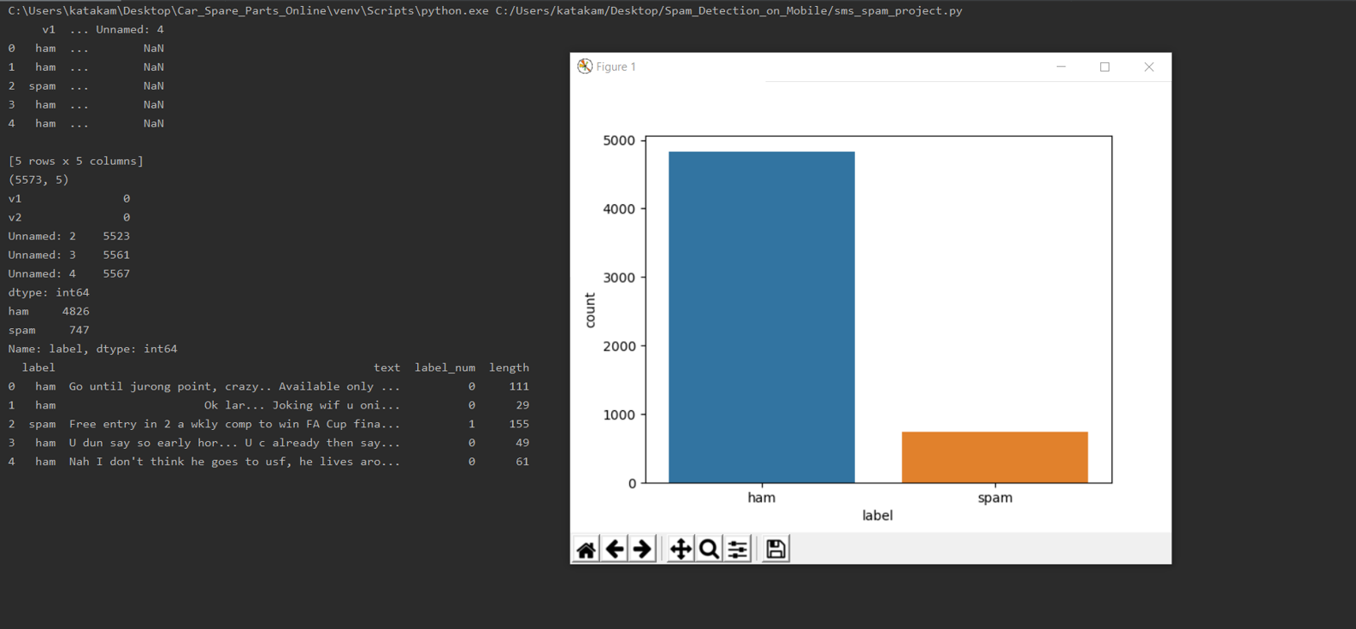

Slide 22
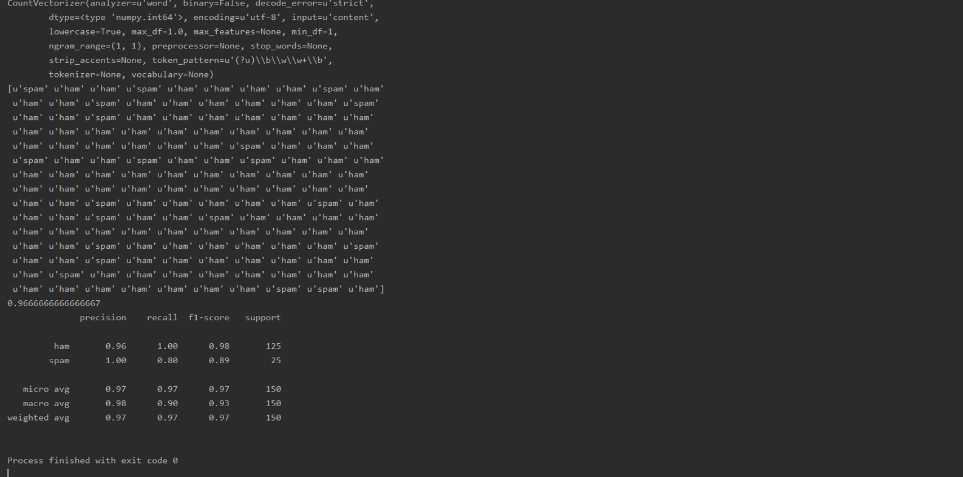

Slide 23
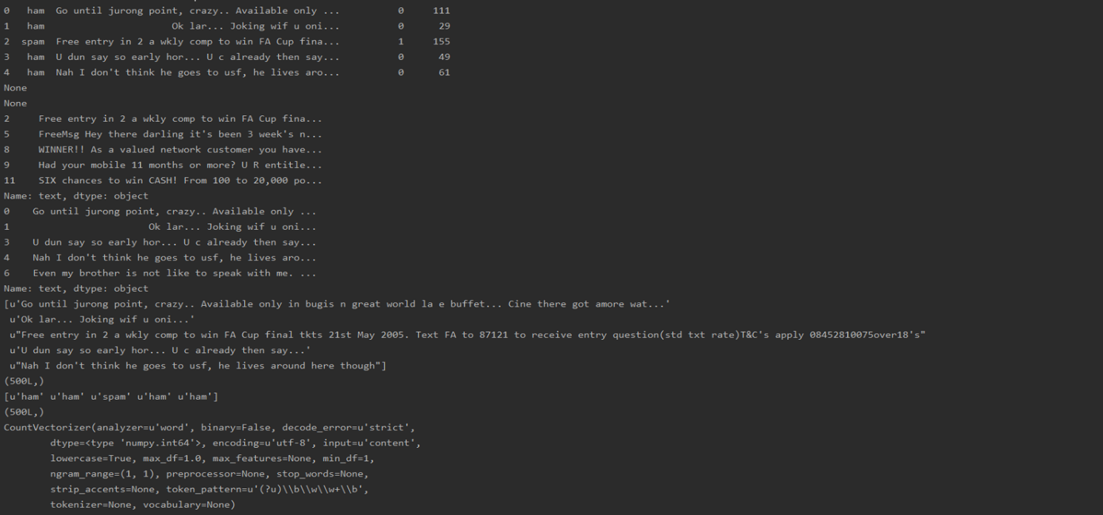

Slide 24
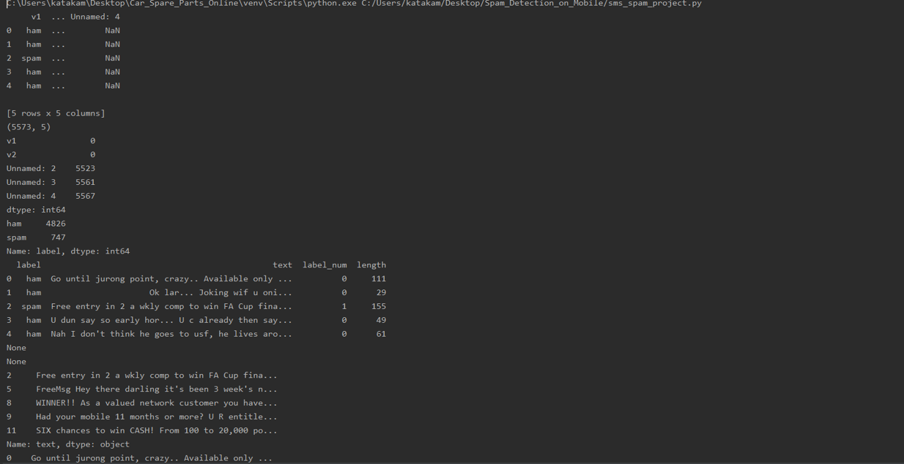

Slide 25
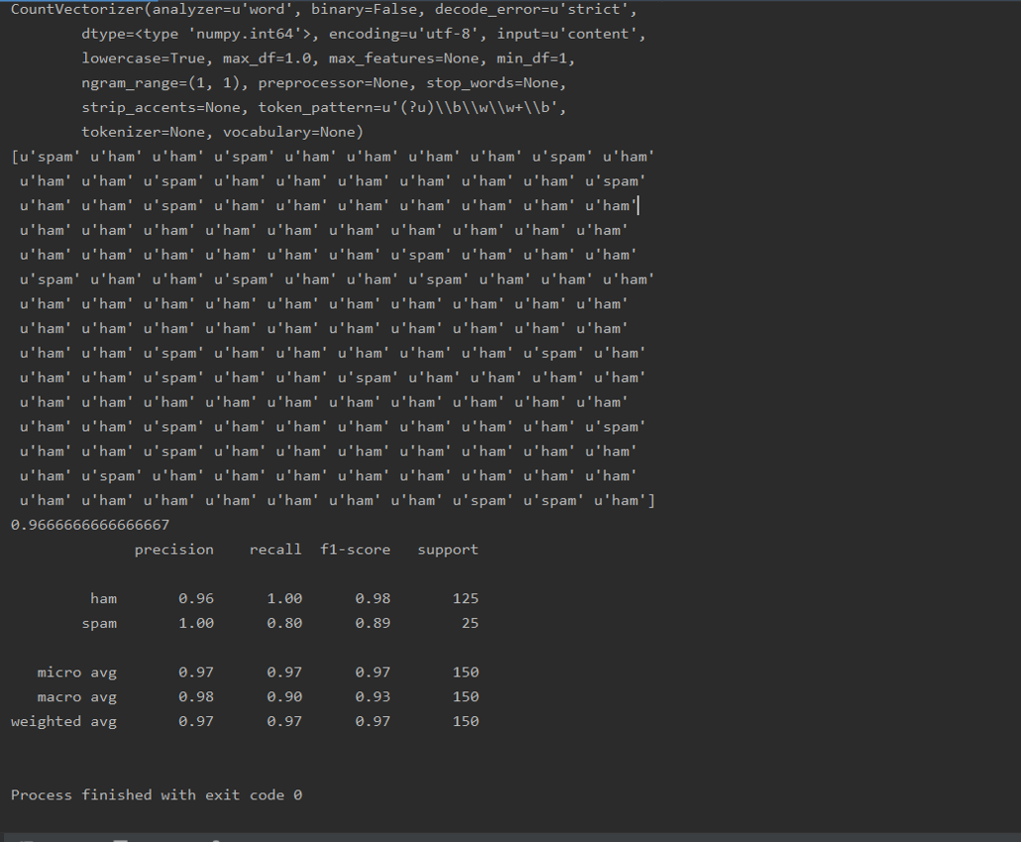

Slide 26
Conclusion:
Based on the analysis of the tests performed in this research, it can be concluded that:
Both methods used in this research, the performances of both methods is equally well for SMS classification with average of the accuracy above 90%. The use of collaboration methods, Naive Bayes and FP-Growth, is superior to the average accuracy for each dataset.
The Accuracy best average is obtained when the SMS Spam Collection v.1 dataset with the 9%minimum support is used and the implementation of the FP-Growth has accuracy up to 98.506%.
The use of datasets with varied training data is agreeable to be applied by using the FP-Growth. By implementing the FP-Growth for feature extraction, it can elevate the score of precision. Thus, the system becomes more precise in providing the information requested by the users in response to the SMS classification.

Slide 27
Future Enhancement:
Though, thesis has made efforts towards solving the problem of Spam E-mail using legislative, behavioral and technological measures, the solution proposed are not complete solutions.
The problem of Spam E-mail and Anti-Spam solution is game of cat and mouse since, every day Spammer will come up with new techniques of sending Spam E-mails. This work has given the potential direction for classification of the Spam E-mails.

Slide 28
References:
https://ieeexplore.ieee.org/abstract/document/7811442/
https://onlinelibrary.wiley.com/doi/full/10.1002/sec.577

Slide 29
Thank You
Notes:
29

